Slide 1
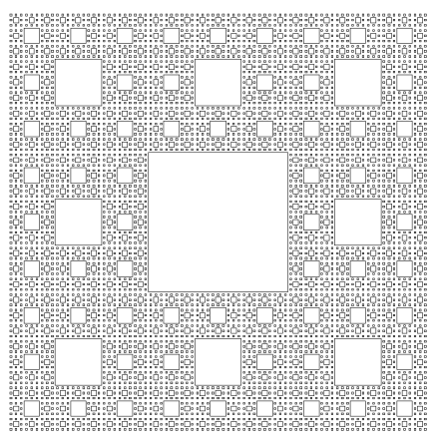
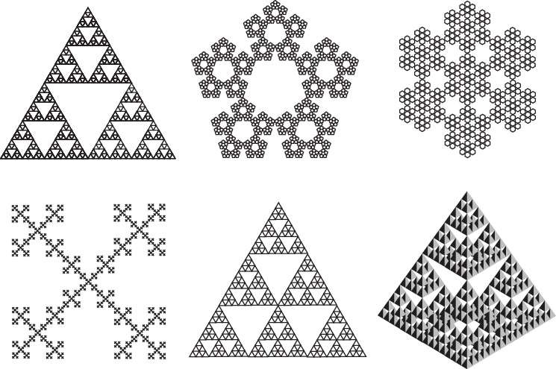
Week 06 - Homework
Modify the examples to produce 2 of the following 3 options:
Sierpinski carpet - based on subdivision of a square instead of a triangle. You can explore iterating different sets of the resulting squares to achieve different patterns

Slide 2
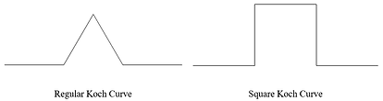
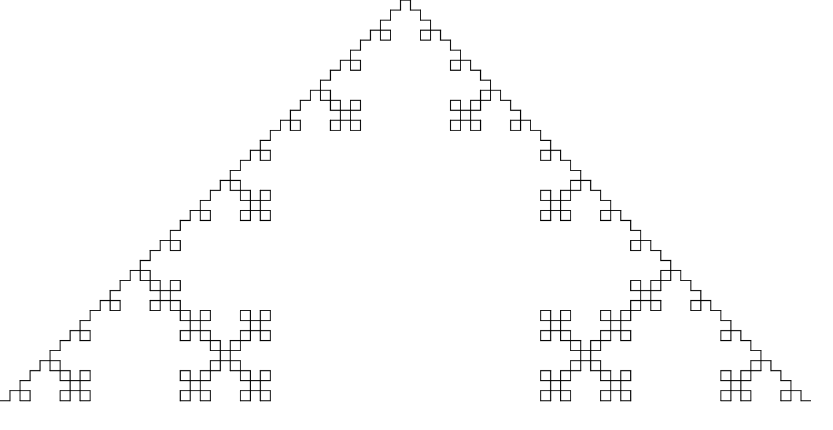
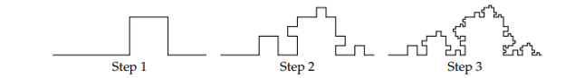
Week 06 - Homework
Square Kock Curve – based on subdivision of a line into 5 segments instead of 4. You can explore moving the “kink” proportionally along the line elsewhere than the mid point

Slide 3
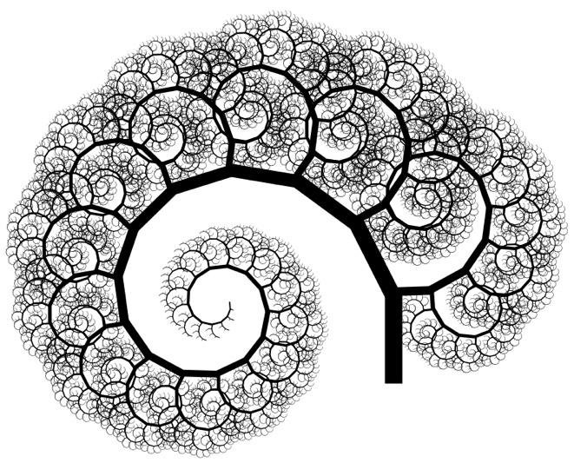
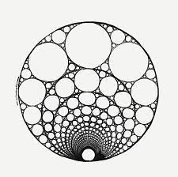
Week 06 - Homework
A fractal of your own choosing. Lots of algorithms can be found on the Web
Add images to this presentation.

